Slide 1
StockMood: A Sentimental Analysis Tool for Stock Performance Prediction
Based on Twitter Sentiment Analysis
Group Members:
Hongyi Zhou (hz2700)
Yunhang Lin (yl4860)
Xiaoran Yuan (xy2508)

Slide 2

Goal
novel?
What we want to do
Our team would build up a tool to help stock investors to make a wise decision based on the sentiment analysis on tweets.
The user can input the name/stock symbol of a company, and our tool will generate a series of sentiment-related graphs to virtualize the current emotion distribution of the specific company.
It will include but is not limited to sentiment graph, key word map, hashtag cluster graph.
Notes:
Introduction of the feasibility of the project ()

Slide 3
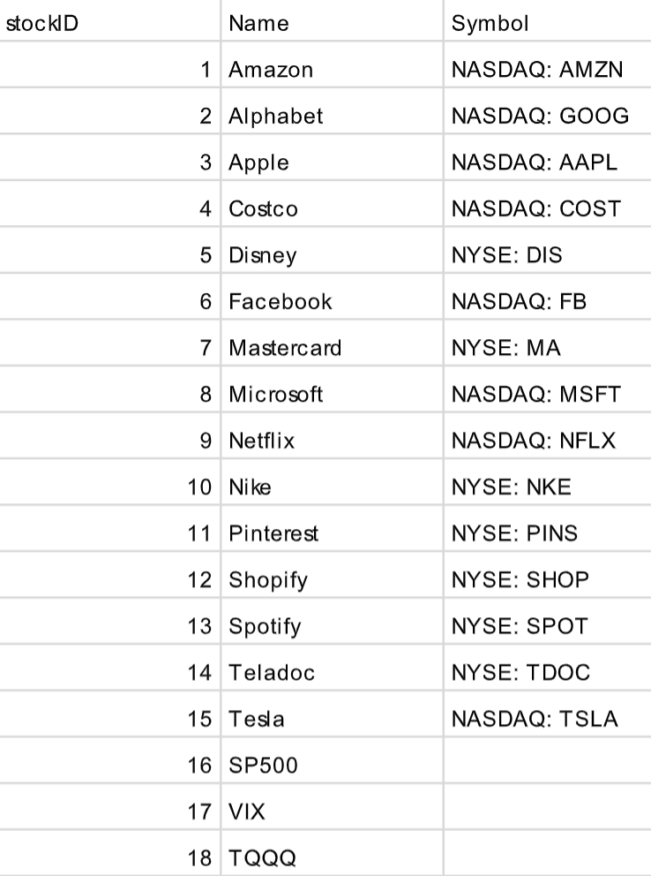
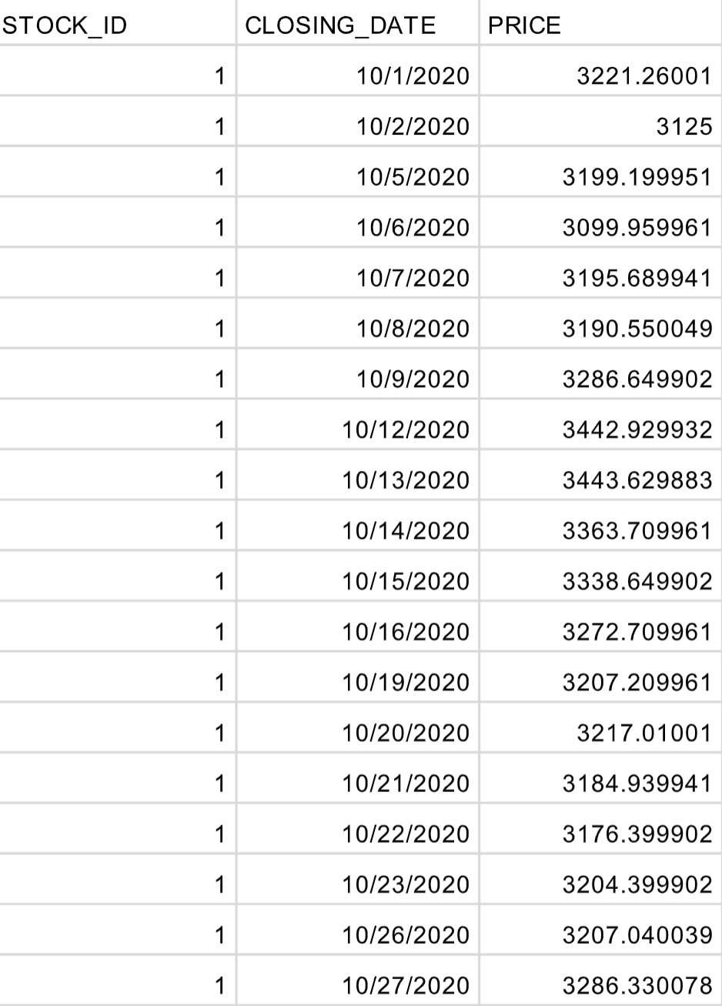
Data (Stock)
Stock list
Stock Price (Source: Yahoo Finance)
Time period:
10/1/2020-10/1/2021

Slide 4
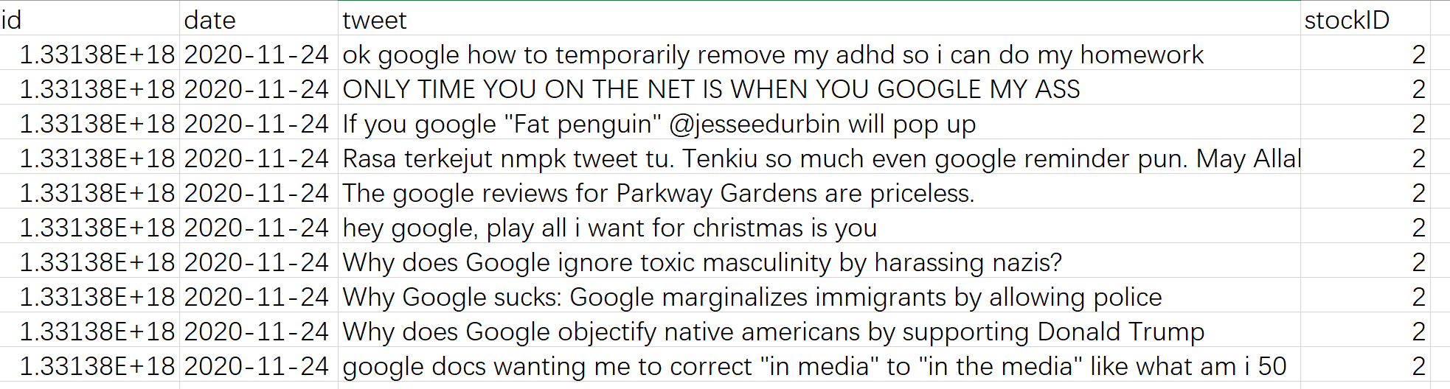
Data (Twitter)
Raw Twitter data
Time period: 10/1/2020-10/1/2021
Volume: 529,881

Slide 5
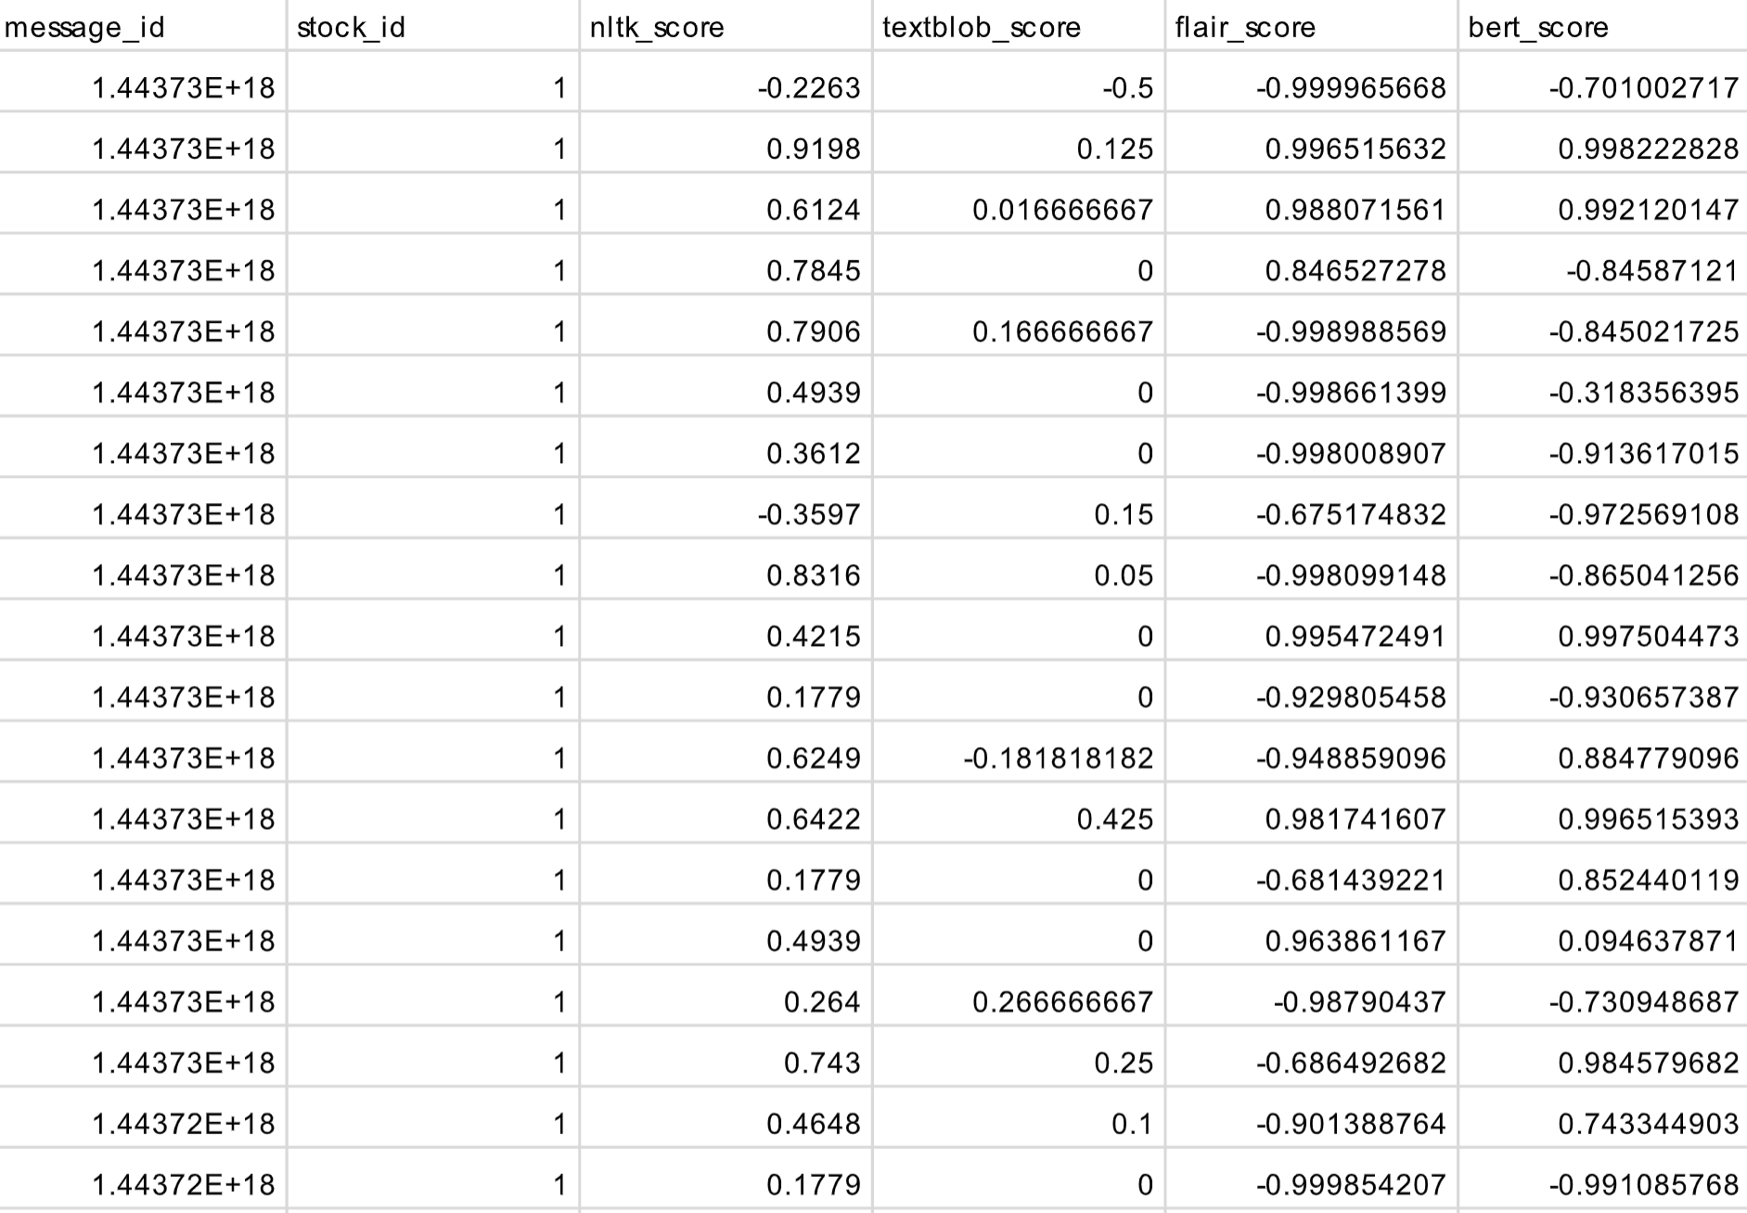




Data (Twitter)
Twitter sentiment score
We tried four models: nltk, textblob, flair, BERT.
Scaled all the scores to [-1,1]
Problem: Different models’ result differ.
Solution: 1) Taking the average
2) Voting
What we have learnt: the usage of the libraries and APIs

Slide 6

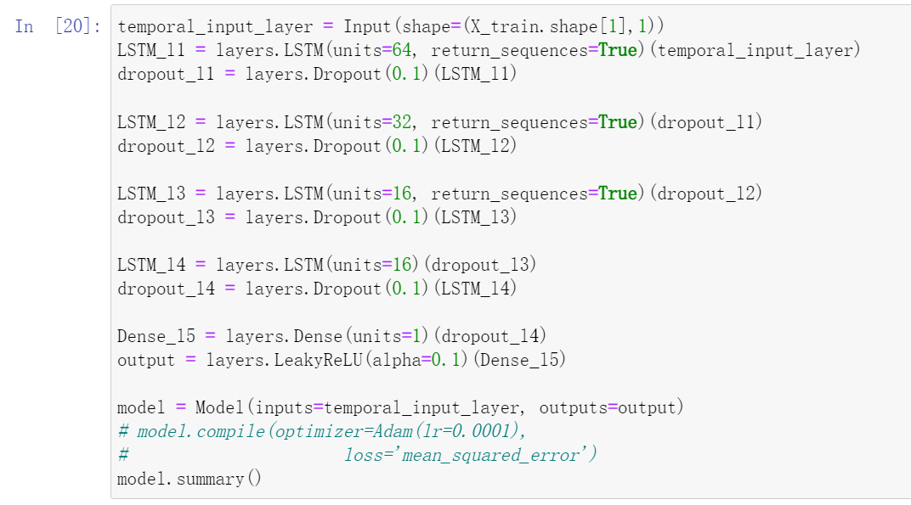
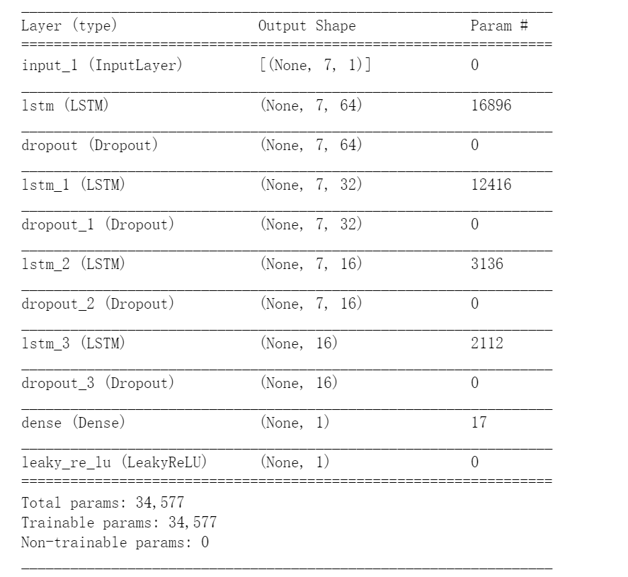
Model
A small sample
Difficulties: Hard to select the optimal training model
Reason: Difficult to estimate the contribution of different hidden layers.
Experiments are time-consuming and labor-intensive
Solution: 1) Refer to the paper and choose the mainstream model
2) Pre-train model
3) Targeted fine tuning

Slide 7
Model
A small sample
What we have learned
Know that RNN (multi-RNN) and LSTM is suitable for time series prediction.
Specific use of code for large-scale data training.
Compare the advantages and disadvantages of different models.

Slide 8
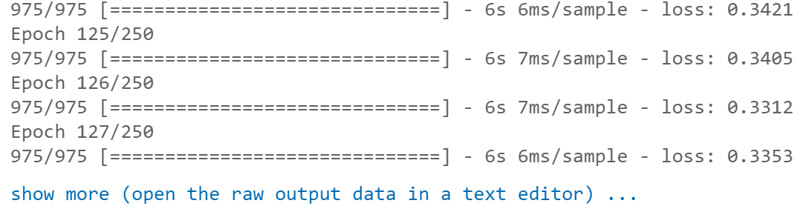
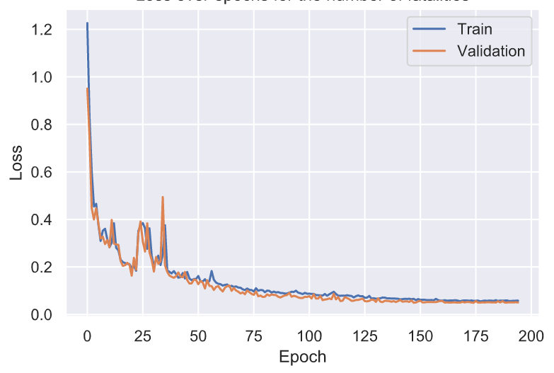
Training
Epochs = 250, batch_size = 16
Use ReduceLROnPlateau() and EarlyStopping() function to control training process.
Use ModelCheckpoint() to store the training data.

Slide 9
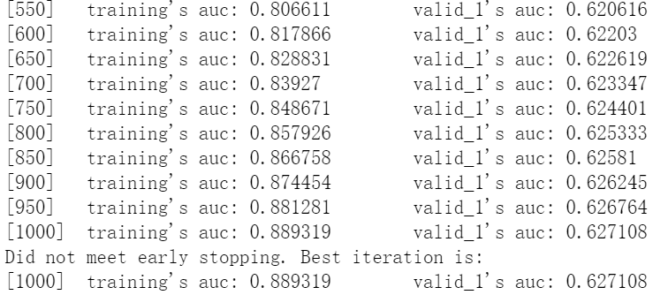
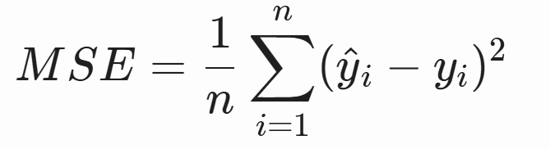
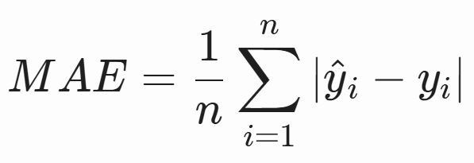
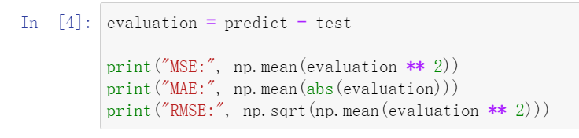
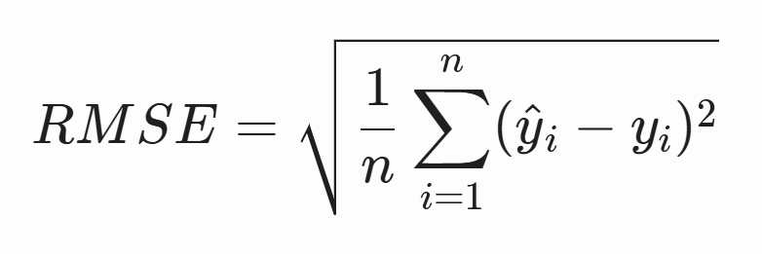
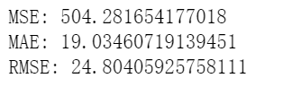
Evaluation
Metric
Accuracy
MSE (Mean Squared Error)
MAE (Mean Absolute Error)
RMSE (Root Mean Square Error)

Slide 10
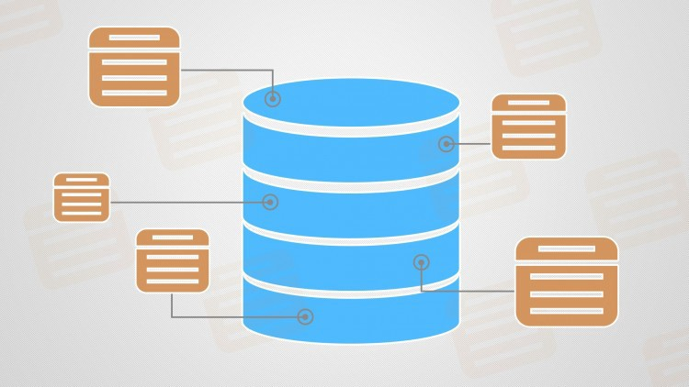


System
Backend Database
Flask
Big Query
JavaScript
HTML
CSS
D3.js
...
Target Users
Ordinary Investors
Financial advisors
Portfolio Managers
SENTIMENT ANALYSIS
Frontend Web Page
Entry-level Investors
...
Sentiment Graph
Tag Cloud Graph
Positivity Score
...
Notes:
Introduce the database backend (which database are we gonna use, what size) and frontend web idea

Slide 11
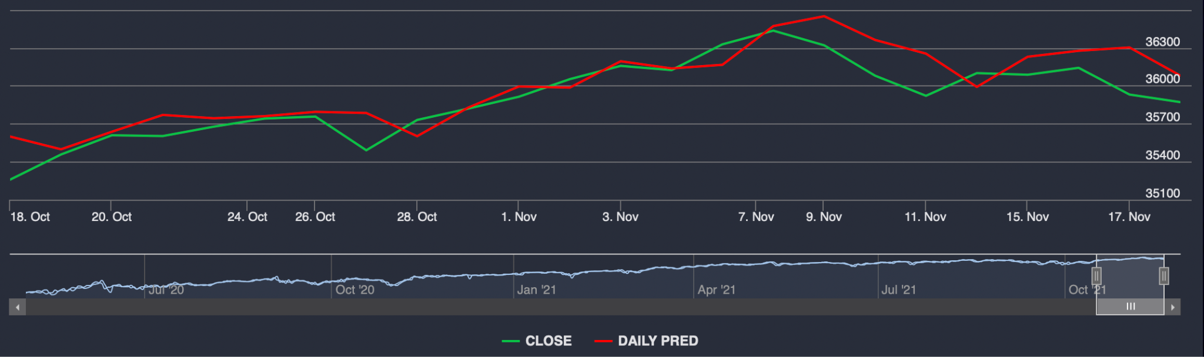
Frontend design and data visualization
Predicted result

Slide 12
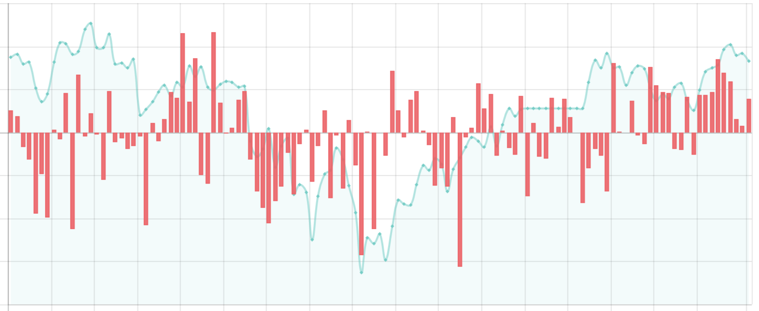
Frontend design and data visualization
Twitter emotional value

Slide 13
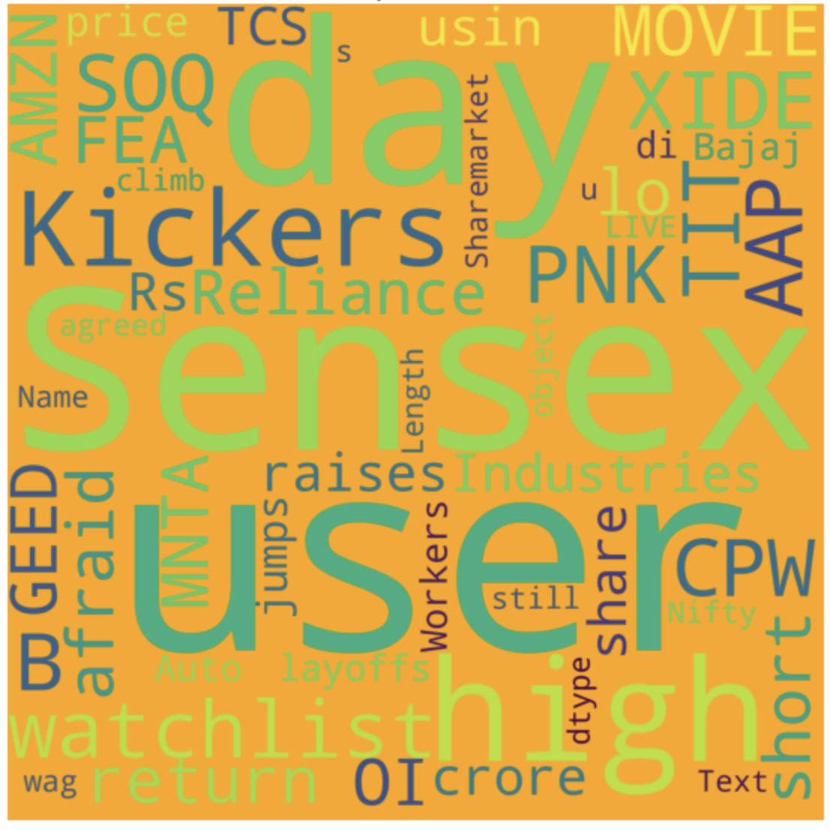
Frontend design and data visualization
Word Cloud
What we learned:
How to use Flask to build web applications
How to use bootstrap and JQuery
Better understanding of D3.js to visualize data

Slide 14
Next Step
Data:
Using methods like Airflow to scratch the new data and update the database each day
Model:
Compare the advantages and disadvantages of different models and choose the most suitable model for stock forecasting.
Continue to optimize the input training data and remove the data classes with weak correlation to reduce the computational load of the model.
Try to expand the amount of data or other methods to improve the accuracy of the results. Reduce the loss metric.
System:
Combine these three data visualization to show result to user
Continue working on backend system and frontend development

Slide 15
Reference
Bartov, E., Faurel, L., & Mohanram, P. S. (2018). Can Twitter help predict firm-level earnings and stock returns?. The Accounting Review, 93(3), 25-57.
Risius, M., Akolk, F., & Beck, R. (2015). Differential emotions and the stock market-the case of company-specific trading.
Sul, H. K., Dennis, A. R., & Yuan, L. (2017). Trading on twitter: Using social media sentiment to predict stock returns. Decision Sciences, 48(3), 454-488.
Wang, Y. (2017). Stock market forecasting with financial micro-blog based on sentiment and time series analysis. J. Shanghai Jiaotong Univ. (Sci.) 22, 173–179.
D'Andrea, Alessia & Ferri, Fernando & Grifoni, Patrizia & Guzzo, Tiziana. (2015). Approaches, Tools and Applications for Sentiment Analysis Implementation. International Journal of Computer Applications. 125. 26-33. 10.5120/ijca2015905866.

